Slide 1
PIC and FLIP Solver for fluid simulation
Group 9: MyStone
Hrishikesh Ghodki, Joel Neuner-Jehle & Lukas Bösiger

Slide 2
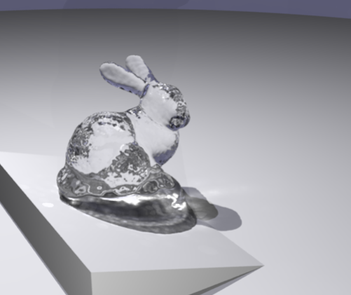
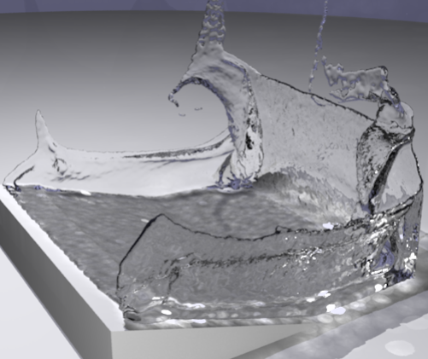
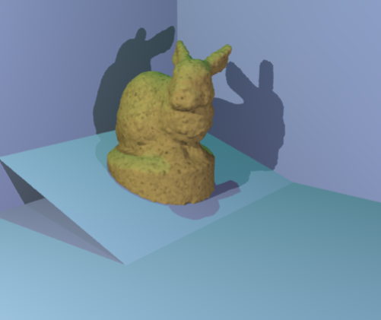
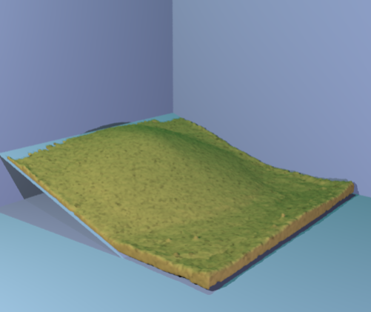
Project Description
Yongning Zhu & Robert Bridson, 2005, ACM: Animating Sand as a Fluid
Minimal Goal:
Fluid simulation with PIC and FLIP
Desired Target:
Sand simulation

Slide 3
Method PIC/FLIP Fluid Simulation
Staggered MAC grid to store fields. e.g pressure, velocity
Initialize fluid Grid cells with 8 particles per cell
Splat particle velocities to grid
Save velocities for FLIP
Apply gravity
Compute and project pressure for incompressibility
Apply boundary conditions
Interpolate grid velocity to particles
For FLIP: Add change of velocity to particles
Advect particles

Slide 4
References
Open3d for visualization of particles as point cloud
2D PIC/FLIP solver: https://github.com/Wimacs/taichi_code
Exercise 4 fluids of the PBS course

Slide 5
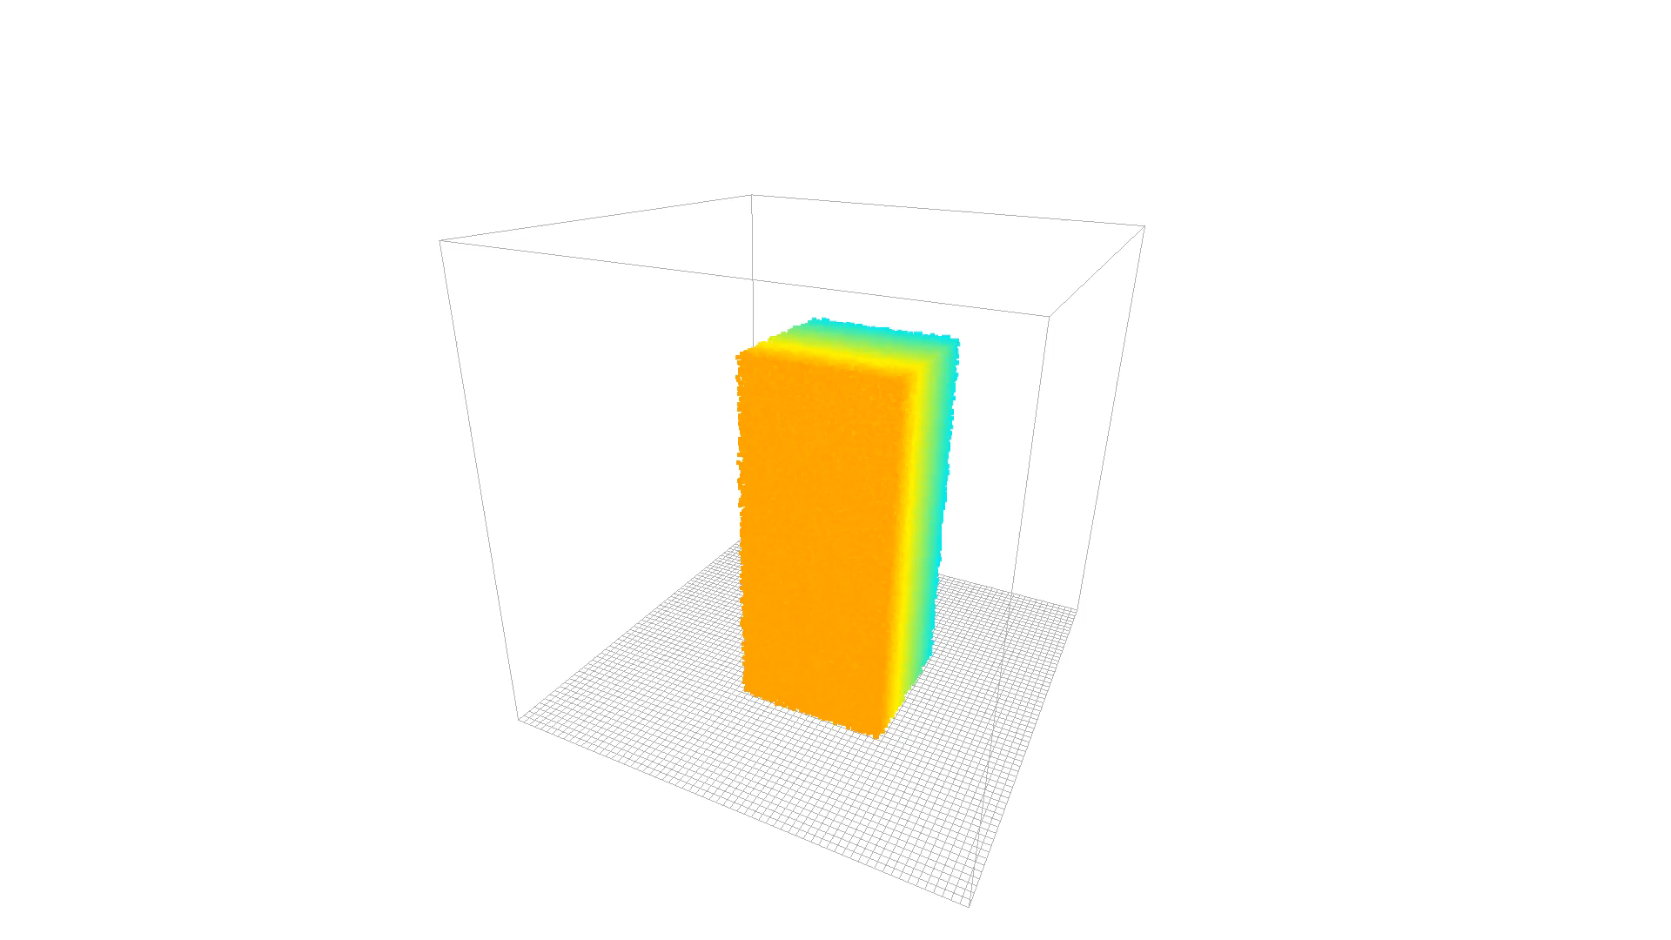
Results FLIP

Slide 6
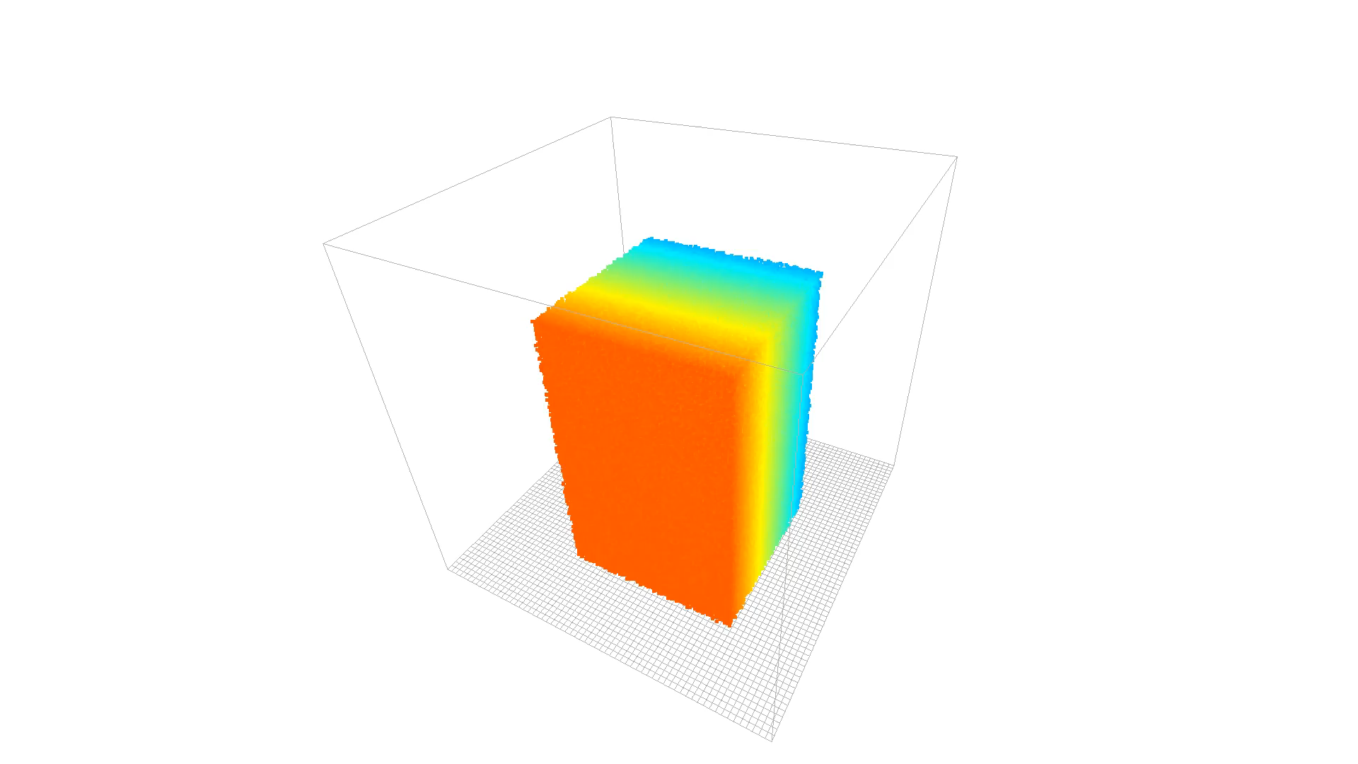
Results PIC

Slide 7
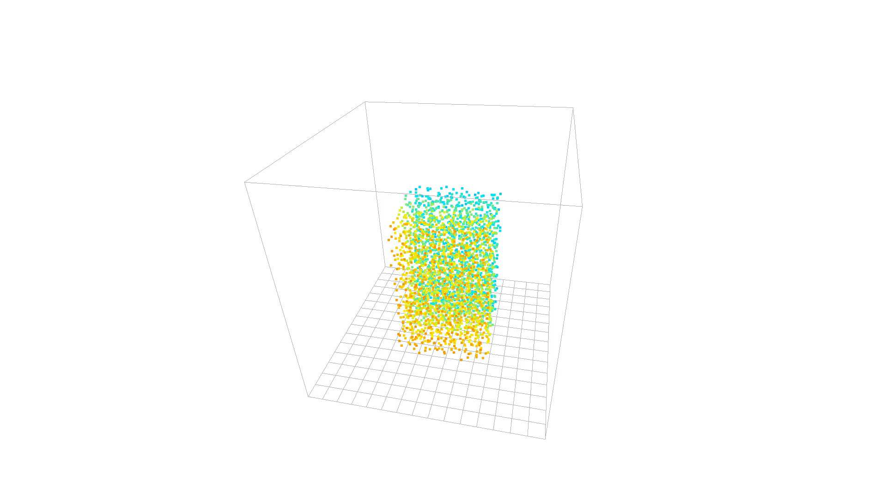
Unfinished Work
Sand Simulation
Surface Reconstruction

